Slide 1
Ada Boost​

Slide 2
Ada Boost
AdaBoost Regression (Adaptive Boosting Regression) is an ensemble learning technique that improves the accuracy of weak regression models by combining them iteratively.
It is a meta-algorithm, and can be used in conjunction with many other algorithms to improve their performance.
Advantages:
Improves weak models by combining them into a strong predictor.
Reduces bias and variance for better accuracy.
Handles noisy data effectively.
Automatically emphasizes important features.
Works with different regression models.
Disadvantages:
Misclassified points get higher weights, impacting performance
Slow for large datasets
If too many weak learners are added, it may overfit.

Slide 3
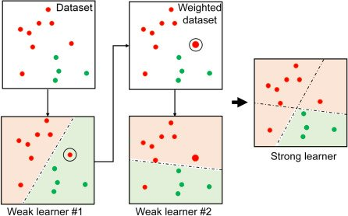
Ada Boost

Slide 4
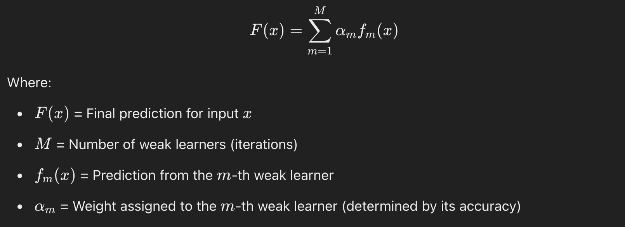
Ada Boost
In AdaBoost Regression, the final prediction is a weighted sum of multiple weak learners (typically Decision Trees).
Formula is:

Slide 5
XG Boost​

Slide 6
XG Boost
XGBoost (Extreme Gradient Boosting) is an advanced boosting algorithm that improves speed and performance using optimized gradient boosting.
XGBoost expects to have the base learners which are uniformly bad at the remainder so that when all the predictions are combined, bad predictions cancels out and better one sums up to form final good predictions.
Advantages:
Parallel processing for high speed
Handles missing data automatically
L1 & L2 regularization to prevent overfitting
Works well with large datasets
Disadvantages:
Computationally intensive
Requires careful tuning
Sensitive to noisy data
Complex to interpret

Slide 7
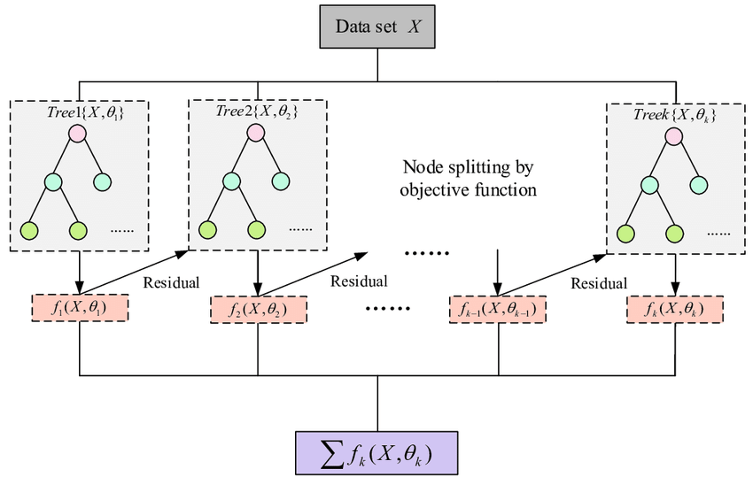
XG Boost

Slide 8
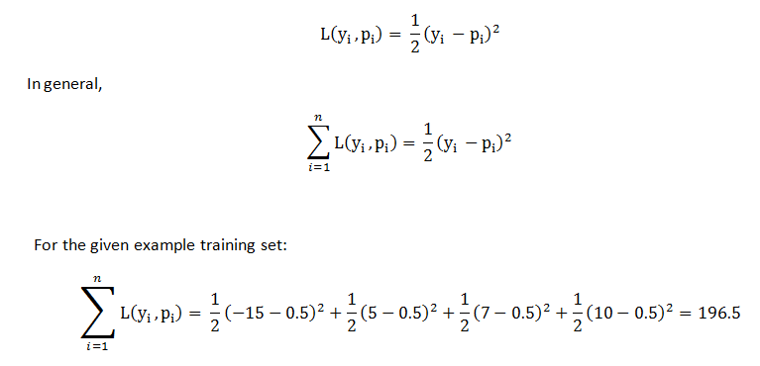
XG Boost

Slide 9
LG Boost​

Slide 10
LG Boost
LightGBM (Light Gradient Boosting Machine) is a fast, high-performance boosting algorithm optimized for large datasets and low memory usage.
LightGBM is not for a small volume of datasets. It can easily overfit small data due to its sensitivity. It can be used for data having more than 10,000+ rows.
Advantages:
Faster than XGBoost – Uses histogram-based splitting
Efficient for Large Datasets – Handles millions of data points
Lower Memory Usage – Optimized for speed and efficiency
Supports Categorical Features – No need for one-hot encoding
Disadvantages:
Sensitive to hyperparameters
Can overfit if not tuned properly
Less interpretable than simpler models

Slide 11
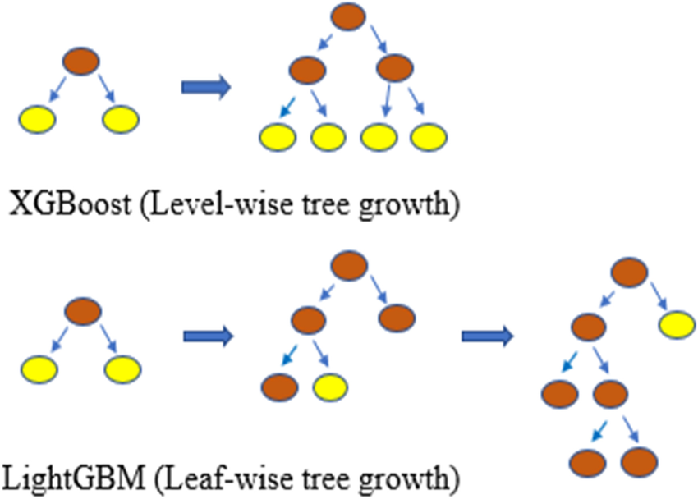
LG Boost

Slide 12
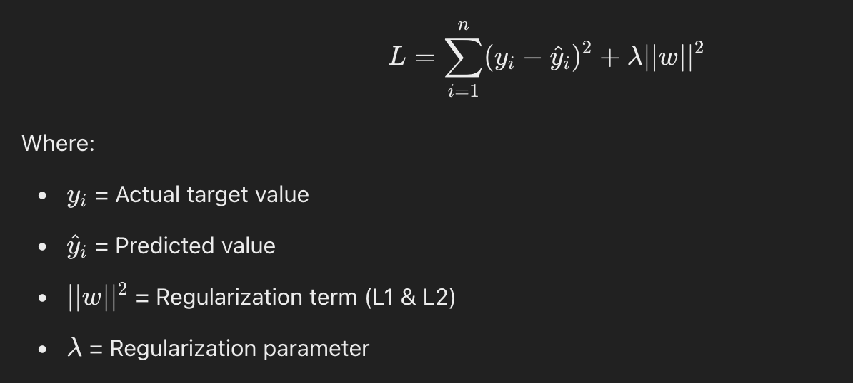
LG Boost

Slide 13
Thank you

